Slide 1
Azure Training Day Migrating .NET applications to Azure

Slide 2

Presentation title
Let’s get Started!
Tell us what you think by completing our survey
Schedule a post-event session to address your specific requirements.
Speaker name
Title
Learn more : aka.ms/techdocs
Get certified : aka.ms/microsoftlearn
Sign up Developer newsletter: aka.ms/usdevconnect

Slide 3


About Me…
Peter De Tender – MCT, Azure MVP
CEO and Lead Technical Trainer of 007FFFLearning.com, +20 years IT experience, mainly datacenters and Microsoft Infrastructure background
Full-time in Azure since 2013 (Readiness & Architect)
Azure Advisor, Azure Certified Architect
Technical Writer, Book author, Courseware Creator
Living in Belgium, but traveling worldwide 90% of my time, helping larger Microsoft Partners, customers and Microsoft FTEs in learning about and using Azure, by providing workshops with passion
peter@pdtit.be
@pdtit @007FFFLearning
http://www.facebook.com/pdtit
http://www.linkedin.com/in/pdtit

Slide 4
Workshop delivery
For the technical trainers:
Each Module could be presented as a stand-alone module, although the full potential comes from delivering all modules
HOL are somehow depending on each other, starting from the IAC-lab, where students deploy the VM-based source environment, moving to WebApps, SQL PaaS, Docker, Azure Container Registry, running Azure Container Instance, and ultimately Azure Container Services with Kubernetes. (only labs that could be skipped are WebApps and AKS)
The HOL solution is based on a ASP.NET Core app « SimplCommerce » (Open Source), using SQL Database

Slide 5
Workshop delivery
For the technical trainers:
Whenever you detect any mistakes, issues, wrong wordings,… in presentations or LAB guides, please send an email to :
msdevseriessupport@007FFFLearning.com, subject « Azure Developer Series – Containers », so we can take care of this and fixing it immediately
Latest version of all content should be available on GitHub:
http://www.github.com/007FFFLearning/MSDevSeriesSupport

Slide 6
Application Migration
Migrating an ASP.NET application to Azure using different Container services
Peter De Tender
@pdtit @007FFFLearning
Aug 2019

Slide 7
Azure DevOps
Deploying applications using CI/CD… and more

Slide 8
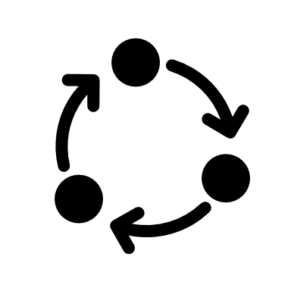



The DevOps methodology
Build
“…DevOps is the union of people,
process and products to enable
continuous delivery of value to
your business and its end-users…”
Deploy
Donovan Brown, Microsoft
Operate

Slide 9
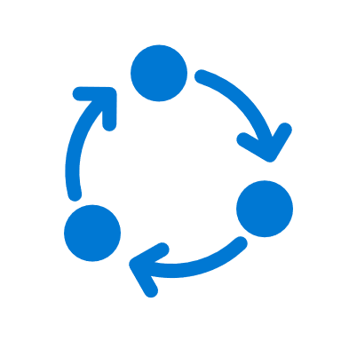



The DevOps Toolkit (Microsoft)
GitHub
Visual Studio
Visual Studio Code
Build
Deploy
Operate
Azure Boards
Azure Repos
Azure Pipelines
Azure Tests
Azure Artifacts
Azure Monitor
Azure App Insights
Azure Security Center

Slide 10



Challenge of DevOps: Different approaches, same cloud endpoint
Application
DevTeam1
Application
DevTeam2
Application
DevTeam3
PRO’s:
DevTeams can run independently
DevTeams are in control
DevTeams enjoy their work
CON’s:
Different teams = different approaches
Different teams = different results
Operational challenges
Security challenges

Slide 11
Solution of DevOps: Same approach, same toolkit, same cloud endpoint
Application
DevTeam1
DEVOPS
Application
DevTeam2
Application
DevTeam3
PRO’s:
DevTeams can run independently
DevTeams are in control
DevTeams enjoy their work
More PRO’s:
Different teams = same approach
Different teams = same results
Operational benefits
Governed and Controlled

Slide 12





Introducing Azure DevOps
“… Azure DevOps is a suite of products that allows any organization to do better DevOps…”
Azure Boards
Azure Pipelines
Azure Repos
Deliver value to your users faster using proven agile tools to plan, track, and discuss work across your teams.
Build, test, and deploy with CI/CD that works with any language, platform, and cloud. Connect to GitHub or any other Git provider and deploy continuously.
Get unlimited, cloud-hosted private Git repos and collaborate to build better code with pull requests and advanced file management.
Azure Test Plans
Azure Artifacts
Test and ship with confidence using manual and exploratory testing tools.
Create, host, and share packages with your team, and add artifacts to your CI/CD pipelines with a single click.

Slide 13
Introducing Azure DevOps
“… Azure DevOps is a suite of products that allows any organization to do better DevOps…”
Azure Boards
Azure Pipelines
Azure Repos
Deliver value to your users faster using proven agile tools to plan, track, and discuss work across your teams.
Build, test, and deploy with CI/CD that works with any language, platform, and cloud. Connect to GitHub or any other Git provider and deploy continuously.
Get unlimited, cloud-hosted private Git repos and collaborate to build better code with pull requests and advanced file management.
Azure Test Plans
Azure Artifacts
Test and ship with confidence using manual and exploratory testing tools.
Create, host, and share packages with your team, and add artifacts to your CI/CD pipelines with a single click.

Slide 14
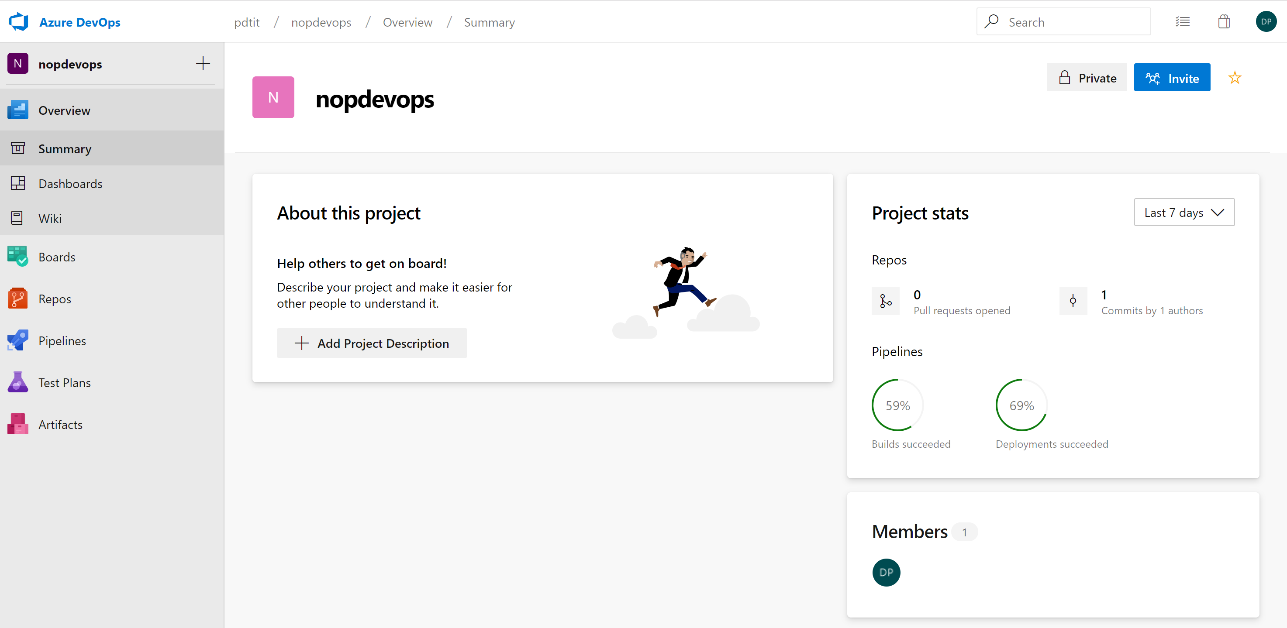
Benefits of Azure DevOps Services
Quick Set-up
Maintenance-free operations
Easy collaboration across domains
Elastic Scale
Rock-solid security
Access to cloud-running build and deployment servers

Slide 15
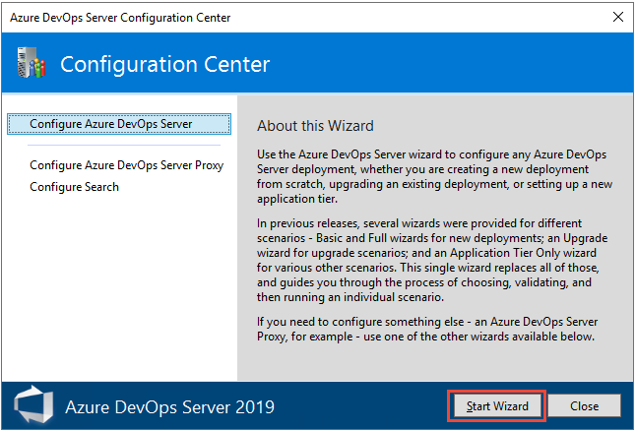
Azure DevOps Server
Simplicity of Azure DevOps from the cloud, in your on-prem datacenter
Data always stays in your own datacenters
Work process and tracking requirements are handled using XML processes model, instead of using the inheritance process model
Azure DevOps Build Server supports both on-premises and cloud-hosted builds
SQL Server and SQL Analysis Server can be added
Single Server
Dual Servers
Multiple Servers
Express Install Mode
Custom Install Mode

Slide 16
Demo
Creating your first Azure DevOps Project

Slide 17


Introducing Azure DevOps
“… Azure DevOps is a suite of products that allows any organization to do better DevOps, where you can choose which products you use…”
JIRA
Azure Pipelines
Git / GitHub
If you do development tracking with Jira instead of Azure Boards, fine, Azure Devops totally integrates with it
Build, test, and deploy with CI/CD that works with any language, platform, and cloud. Connect to GitHub or any other Git provider and deploy continuously.
If you don’t want to use Azure Repos, fine, use Git / GitHub instead; Azure DevOps totally integrates with it
Main benefit is the openness
Azure Test Plans
Azure Artifacts
Test and ship with confidence using manual and exploratory testing tools.
Create, host, and share packages with your team, and add artifacts to your CI/CD pipelines with a single click.

Slide 18

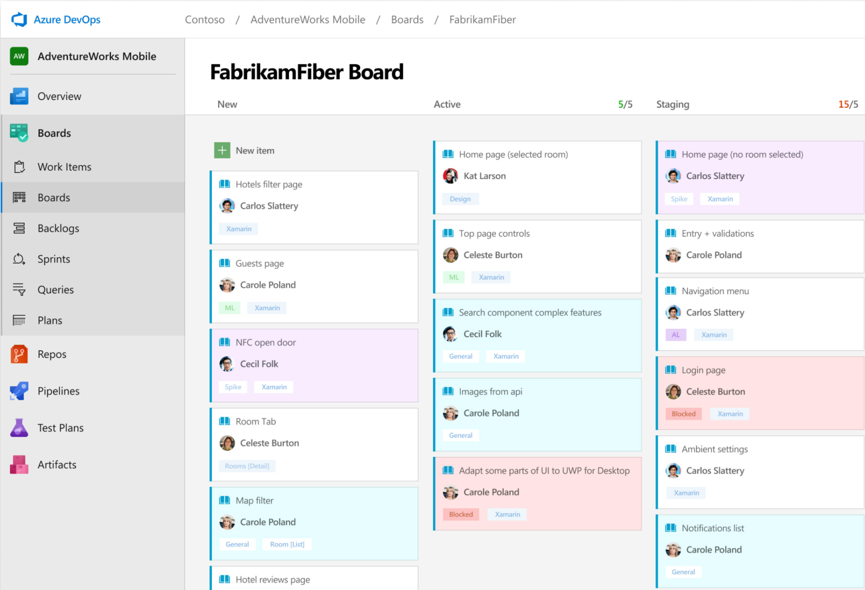


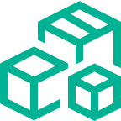
Azure Boards
Track work with Kanban boards, backlogs, team dashboards and custom reporting
Drag & Drop Sprint Planning
Flexible work item tracking, using comprehensive traceability to have the perfect environment to manage your development projects and processes
Scrum-ready
Use built-in Scrum boards and planning tools to help your teams run sprints, stand-ups, and planning meetings
Integration with GitHub
Boost your teams productivity with Boards, Backlogs and Sprints for easy or most complex projects. Connect your GitHub Repo to Azure Boards and start linking commits and PRs to work items
➔
https://azure.com/boards

Slide 19
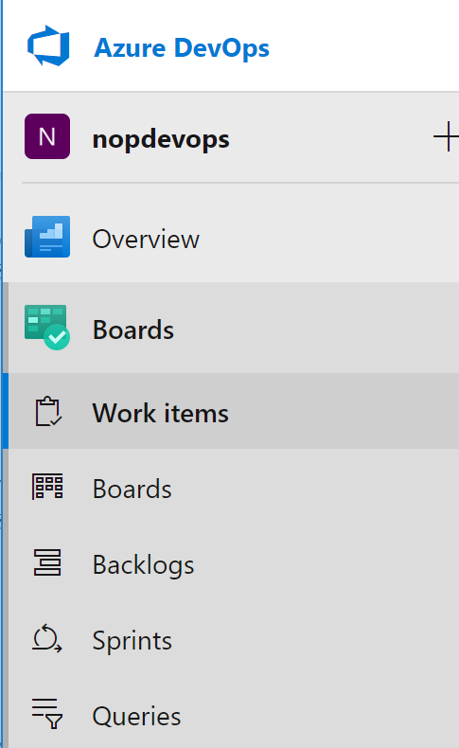
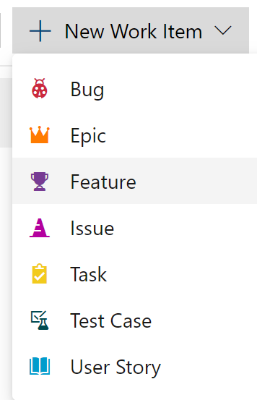
Azure Boards
Work Items
Boards
Backlogs
Sprints
Queries

Slide 20
Demo
Azure Boards

Slide 21
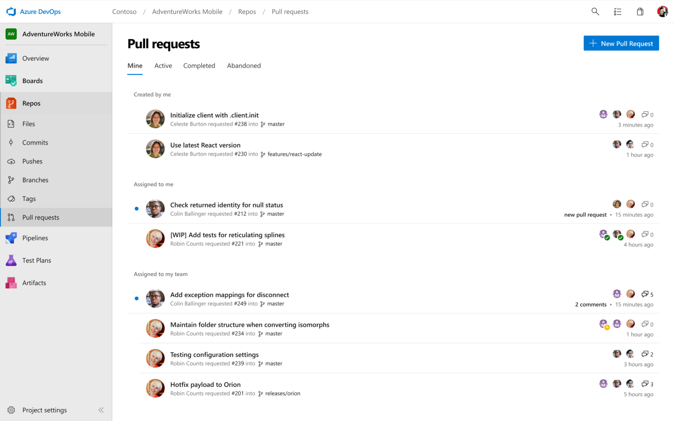
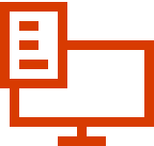

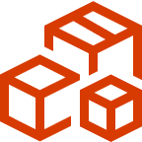
Azure Repos
Cloud-hosted, unlimited private Git Repositories for your projects
Support for any Git Client
Securely connect with and push code into your Git Repos from any IDE, editor or Git Client
Collaborate to build better code
Perform more effective Git code reviews with threaded discussion and continuous integration for each change. Use forks to promote collaboration with inner source workflows
Protect your code with branches
Keep code quality high by requiring signoff, successful builds, and passing tests before pull requests can be merged. Customize your branch policies to maintain your team’s standards
➔
https://azure.microsoft.com/en-us/services/devops/repos/

Slide 22
Demo
Azure Repos

Slide 23
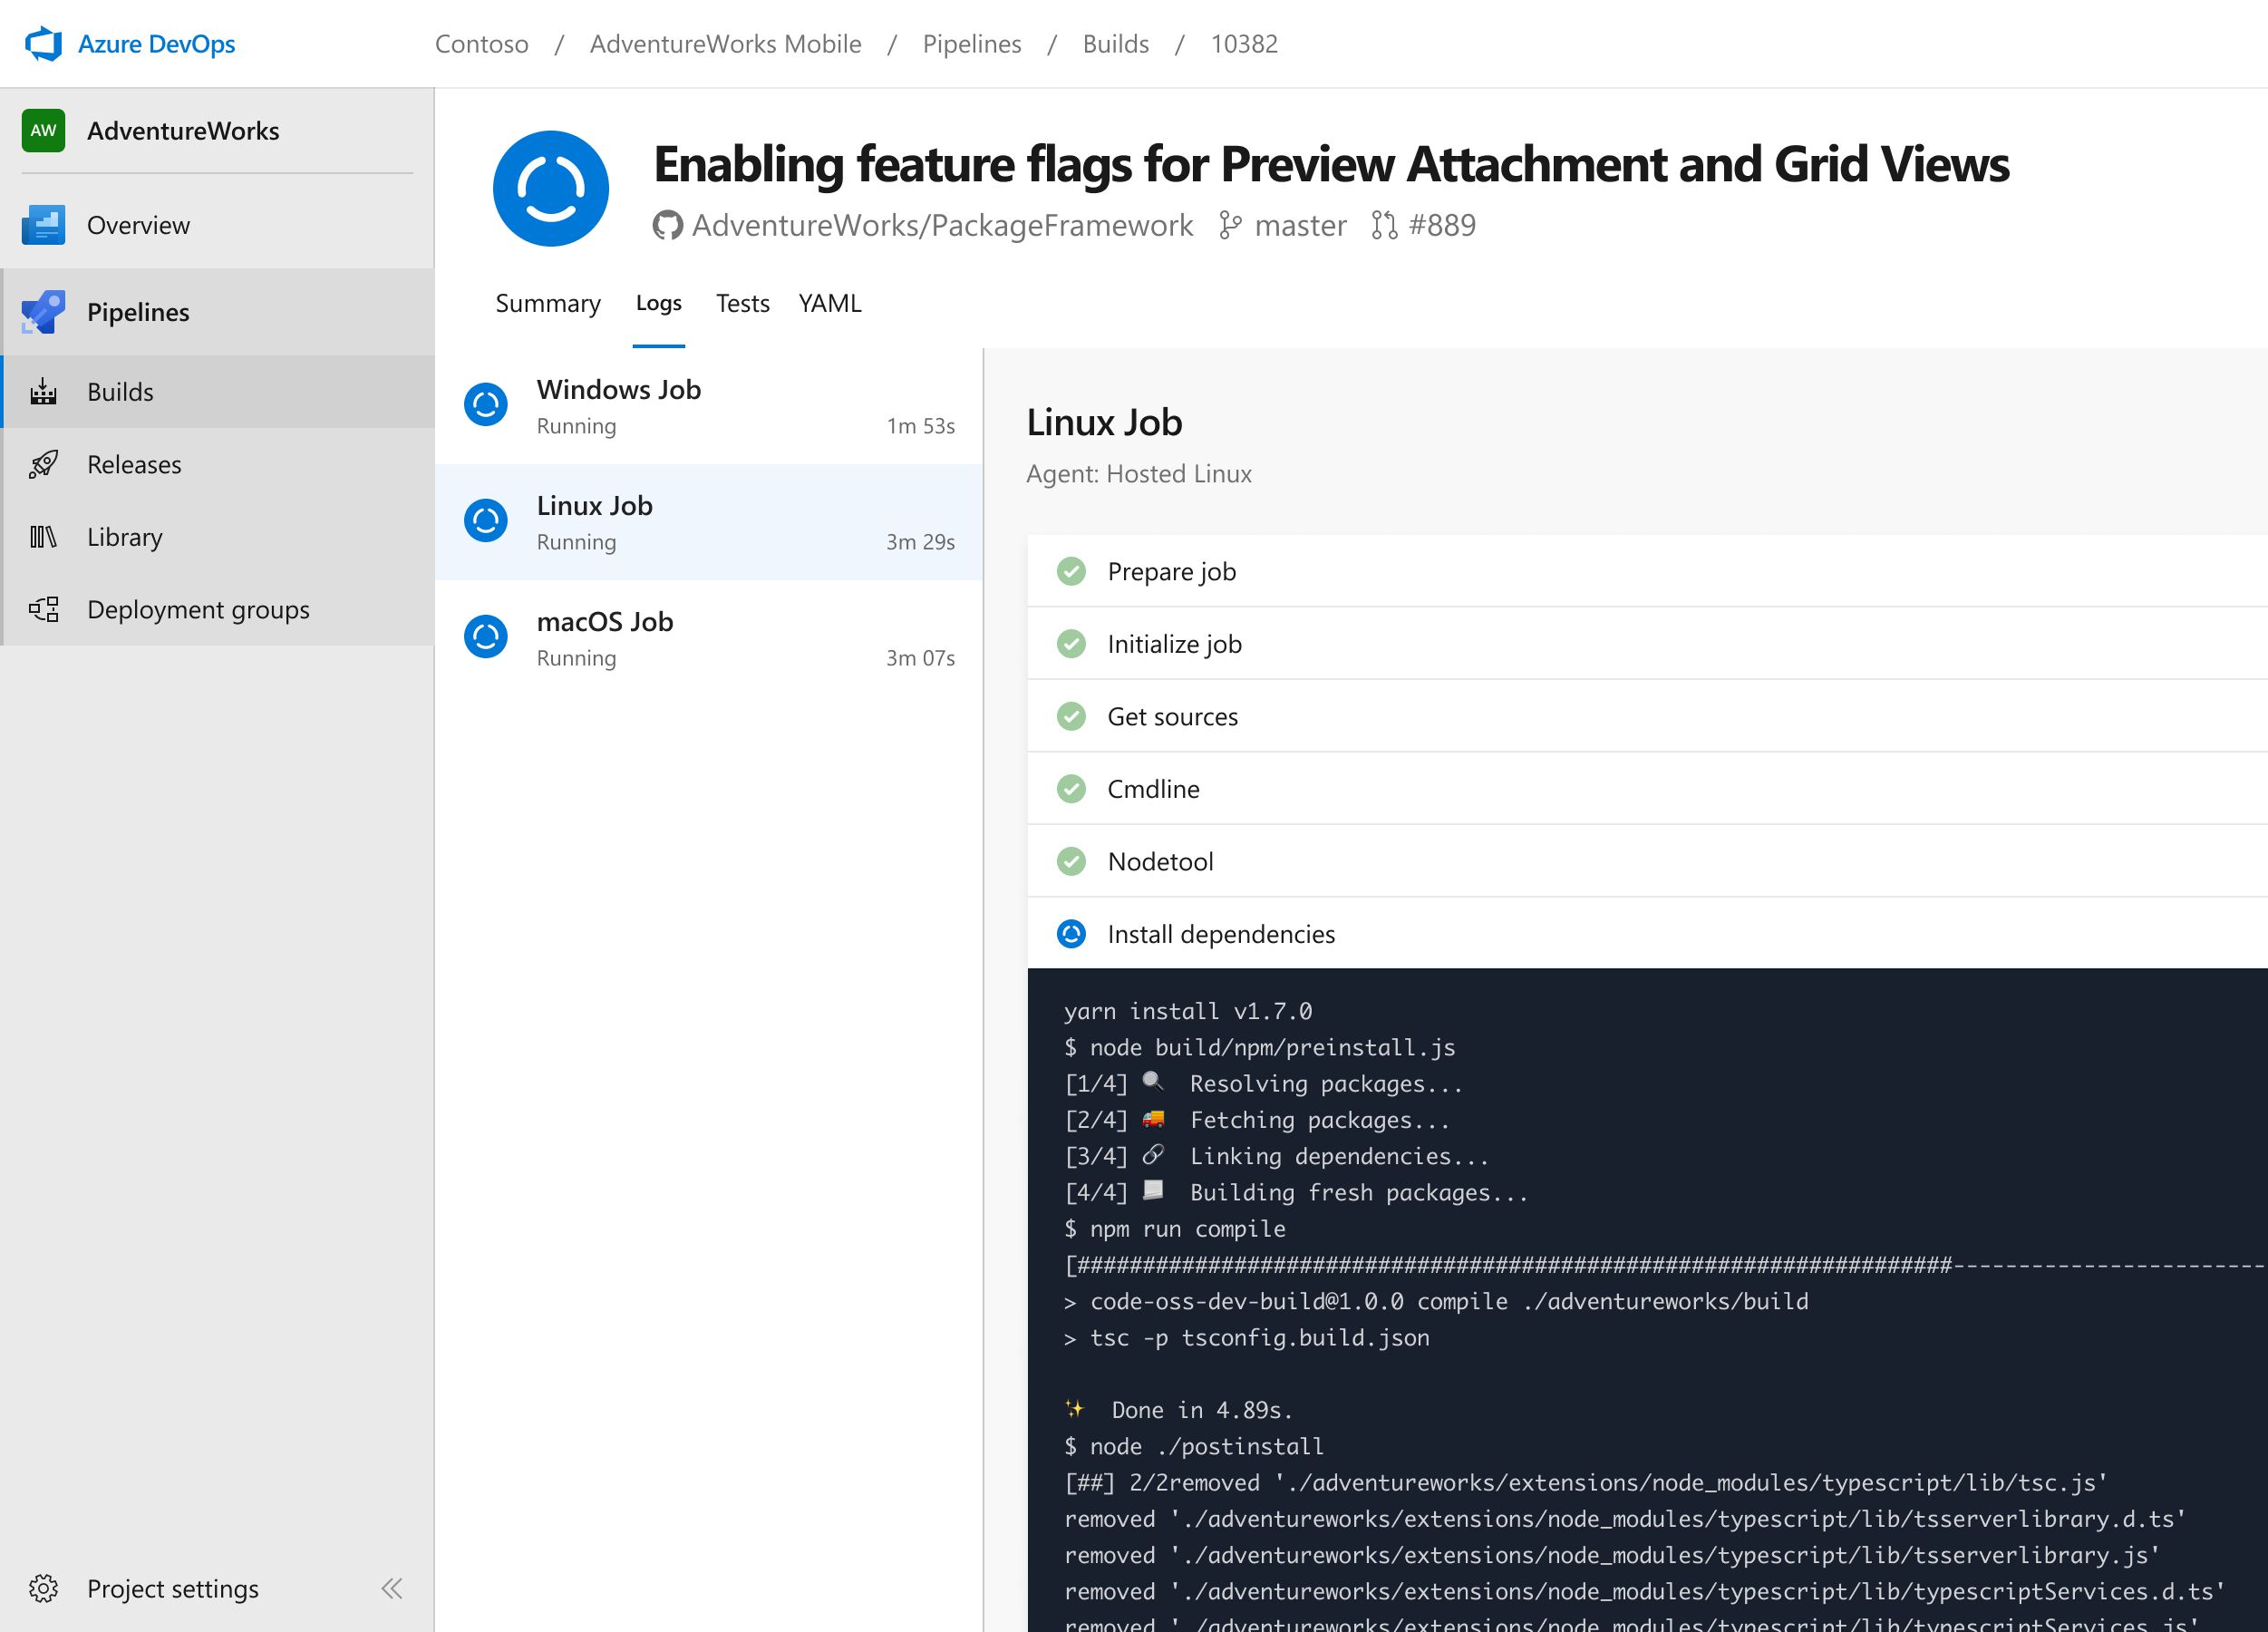



Azure Pipelines
Cloud-hosted pipelines for Linux, Windows and macOS.
Any language, any platform, any cloud
Build, test, and deploy Node.js, Python, Java, PHP, Ruby, C/C++, .NET, Android, and iOS apps. Run in parallel on Linux, macOS, and Windows. Deploy to Azure, AWS, GCP or on-premises
Extensible
Explore and implement a wide range of community-built build, test, and deployment tasks, along with hundreds of extensions from Slack to SonarCloud. Support for YAML, reporting and more
Containers and Kubernetes
Easily build and push images to container registries like Docker Hub and Azure Container Registry. Deploy containers to individual hosts or Kubernetes.
➔
https://azure.com/pipelines

Slide 24
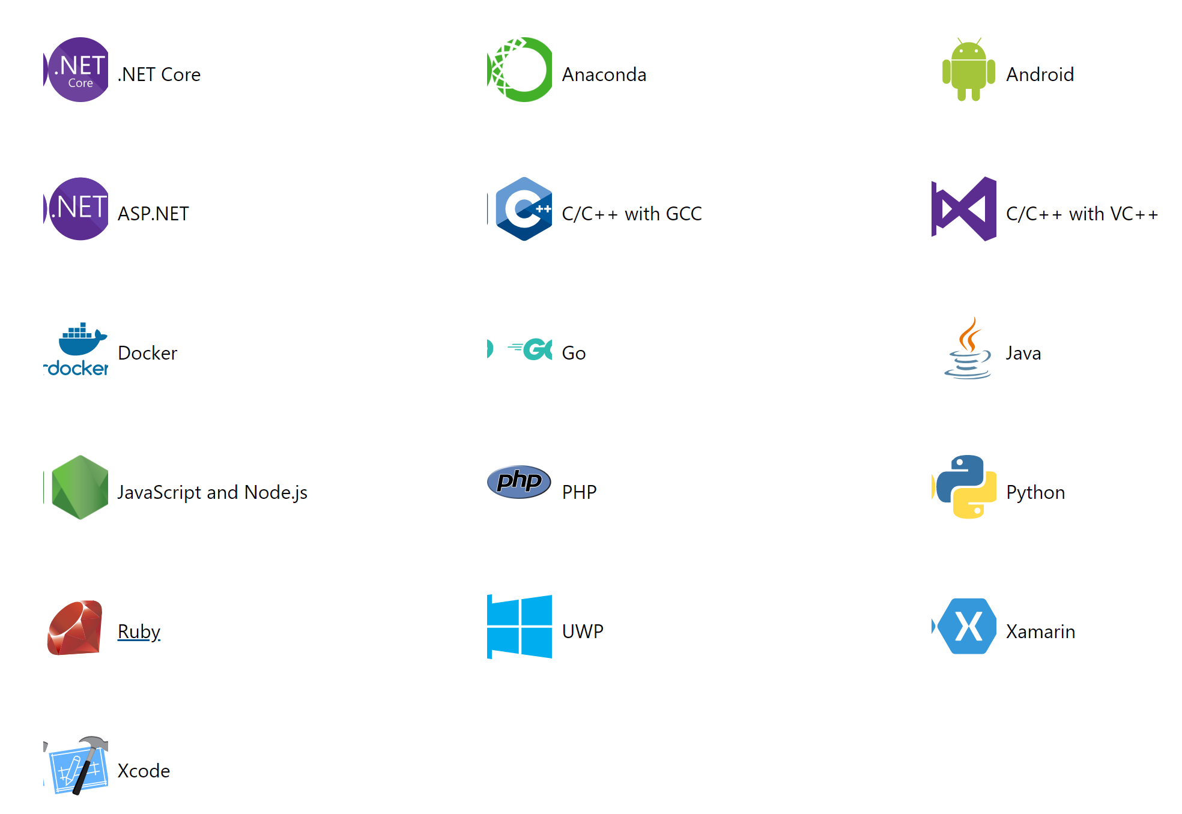
Running a Build with Azure DevOps Pipelines
Supporting multiple languages
Prerequisites:
A GitHub Account
An Azure DevOps Organization
Application Source Code
Based on your source code, Azure DevOps Pipelines “recognizes” the capabilities
The output of the Pipelines process is a “Azure-Pipelines.yml” file

Slide 25
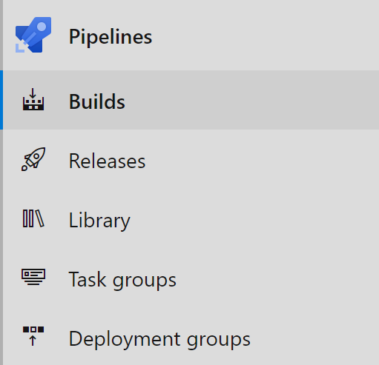
Building a Pipeline for .NET Core applications
New Build Pipeline

Slide 26
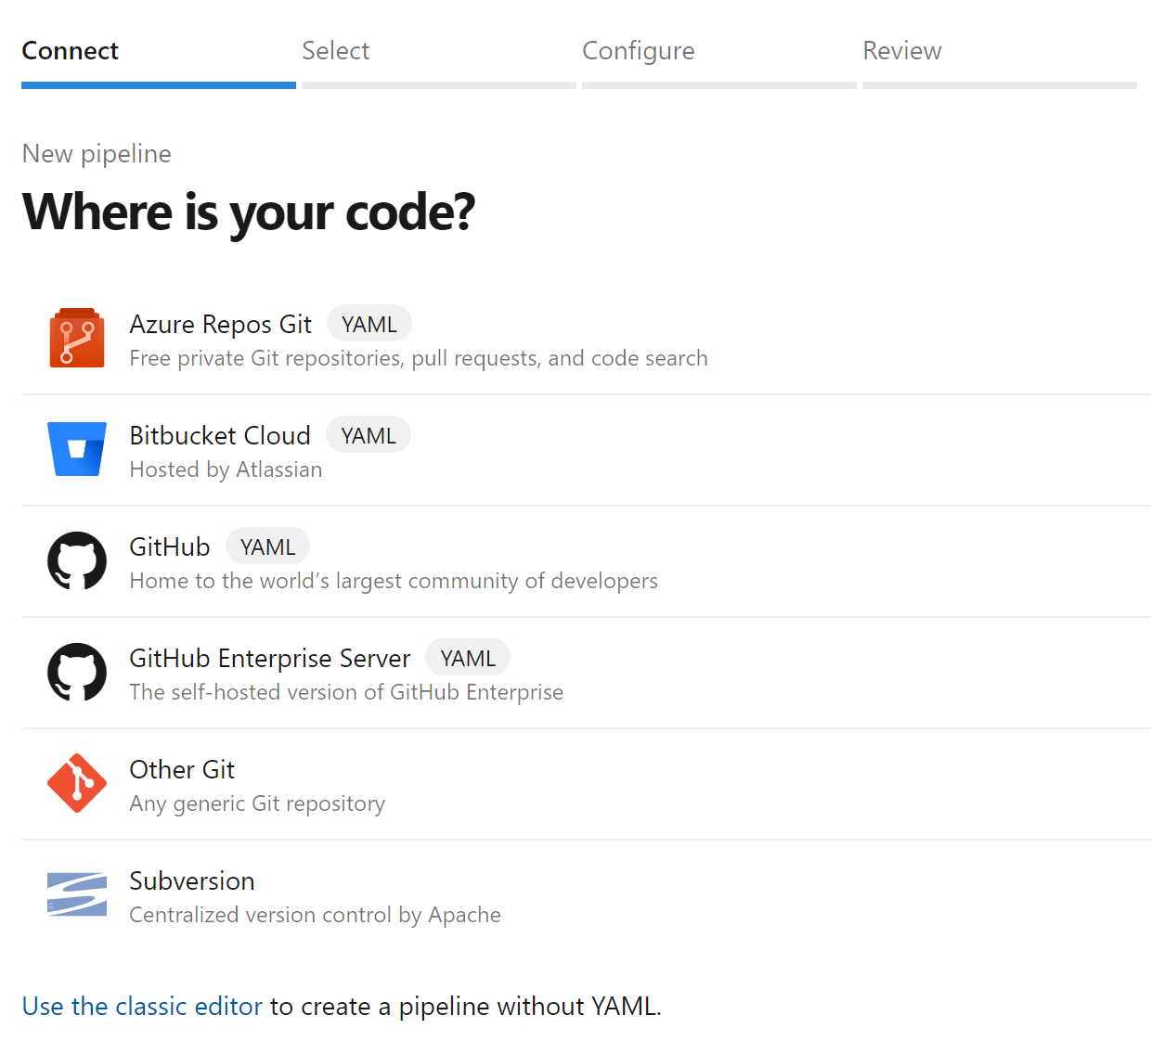
Building a Pipeline for .NET Core applications
New Build Pipeline
Select Source Control environment

Slide 27
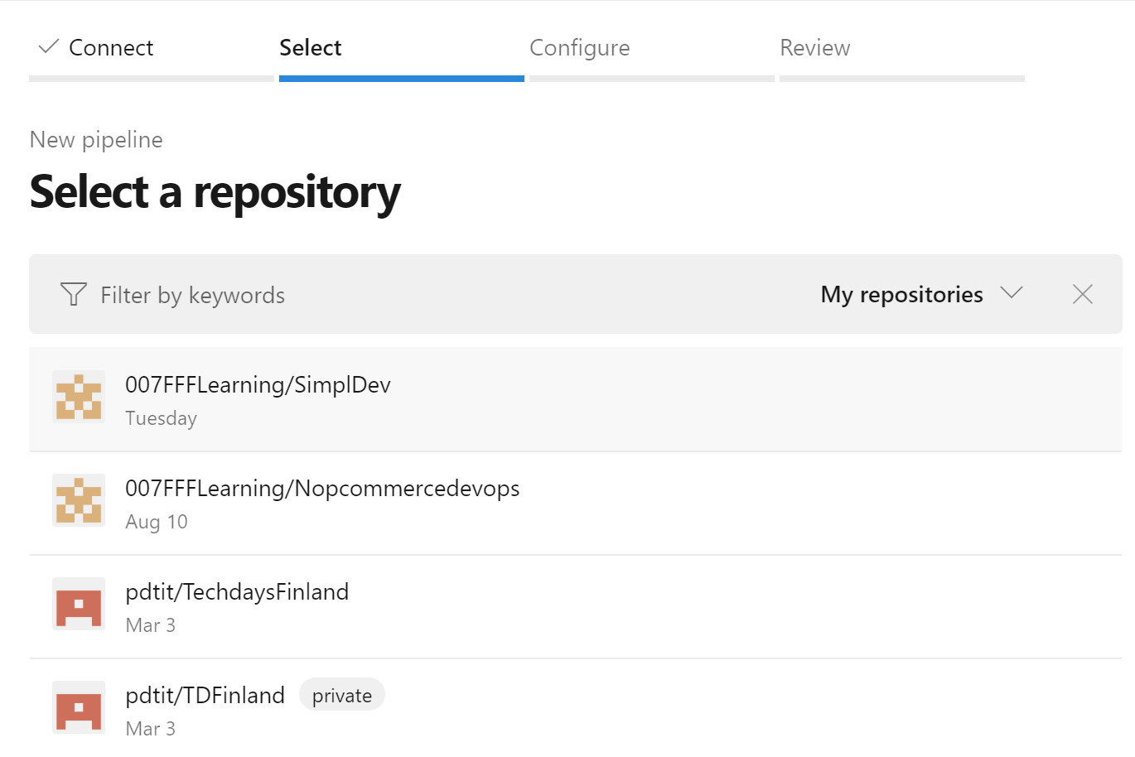
Building a Pipeline for .NET Core applications
New Build Pipeline
Select Source Control environment
Select Repo

Slide 28
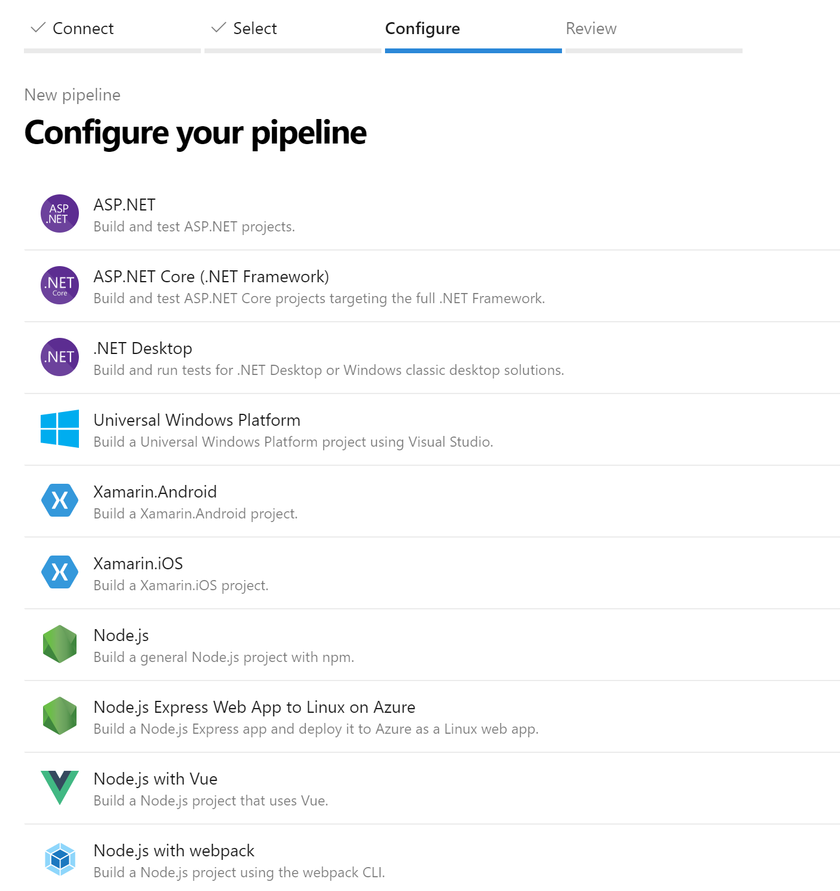
Building a Pipeline for .NET Core applications
New Build Pipeline
Select Source Control environment
Select Repo
Azure Pipelines analyzes the source code, and provides “options” for Build

Slide 29
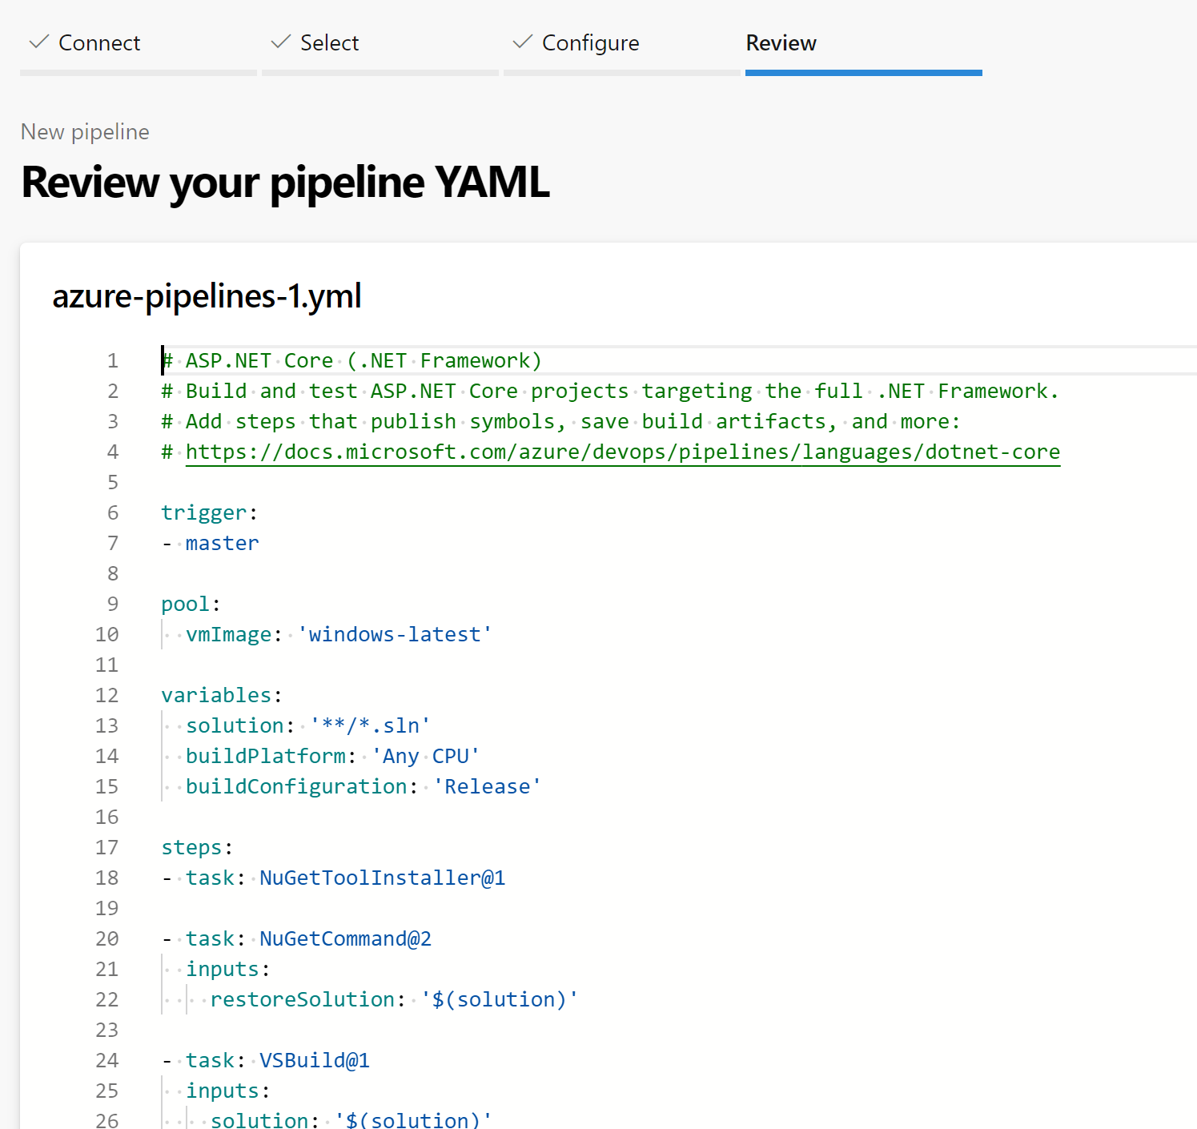
Building a Pipeline for .NET Core applications
New Build Pipeline
Select Source Control environment
Select Repo
Azure Pipelines analyzes the source code, and provides “options” for Build
This results in a “Azure-pipelines.yml” file

Slide 30
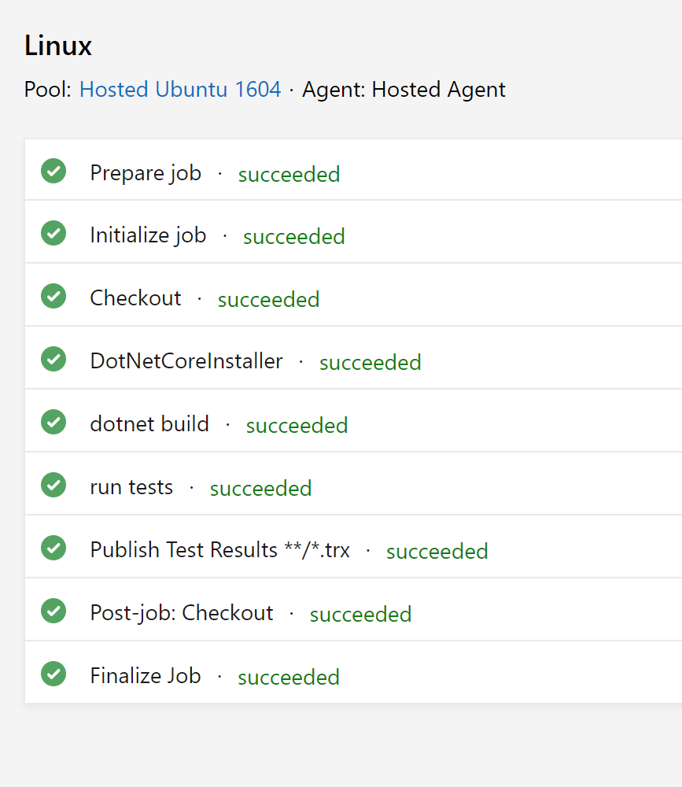
Building a Pipeline for .NET Core applications
New Build Pipeline
Select Source Control environment
Select Repo
Azure Pipelines analyzes the source code, and provides “options” for Build
This results in a “Azure-pipelines.yml” file
Create and Run your Build

Slide 31
Demo
Using Azure Pipelines to create your Build
Source Code to Web Apps
Source Code to Docker Container

Slide 32
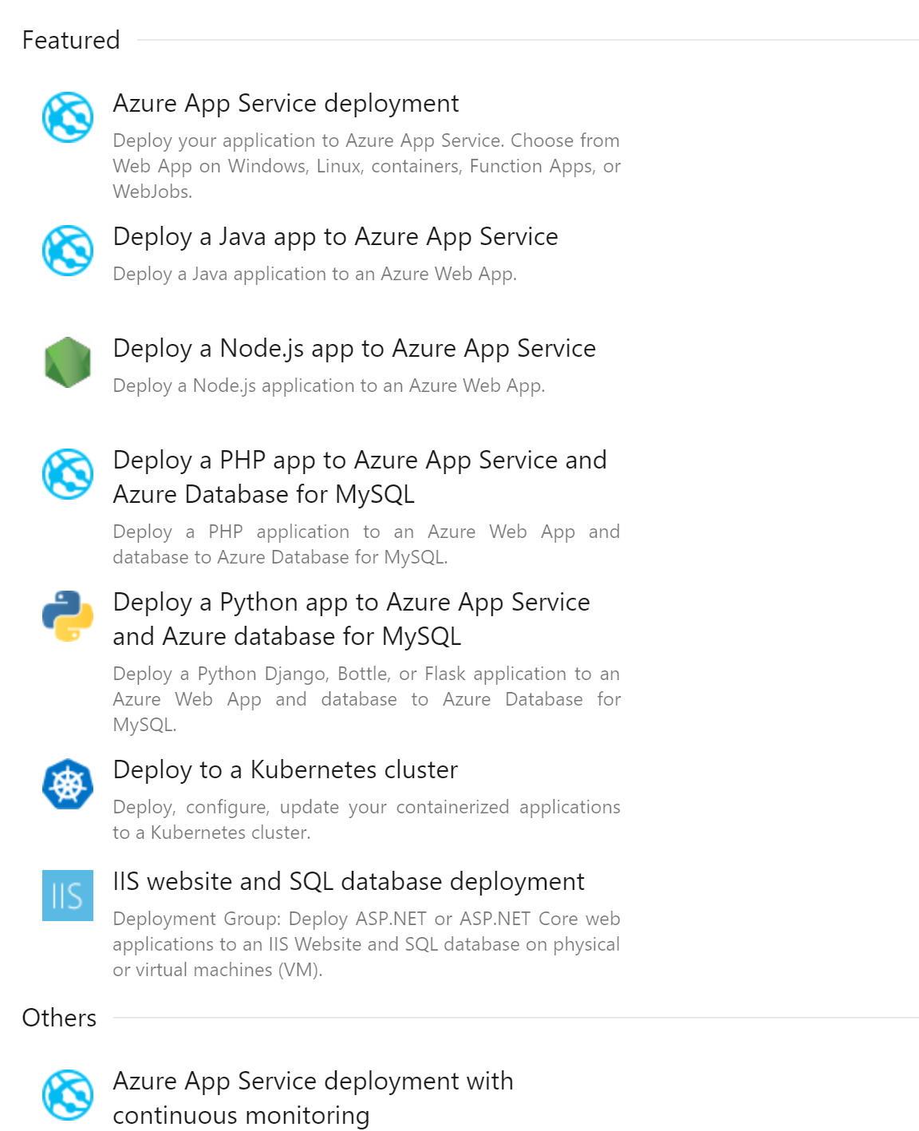
Running a Release with Azure DevOps Pipelines
Supporting multiple languages
Start from a template, or blank
Based on a Pipeline build artifact, or other sources
Single or multi-staged release scenarios

Slide 33
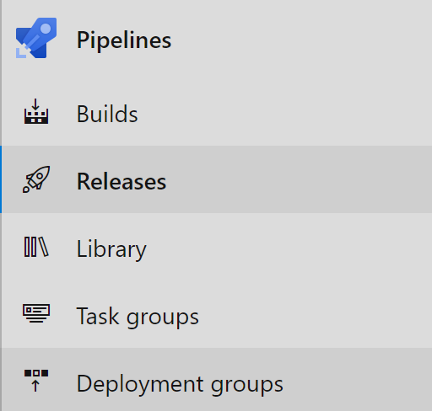
Configuring a Release Pipeline for .NET Core applications
New Release Pipeline

Slide 34
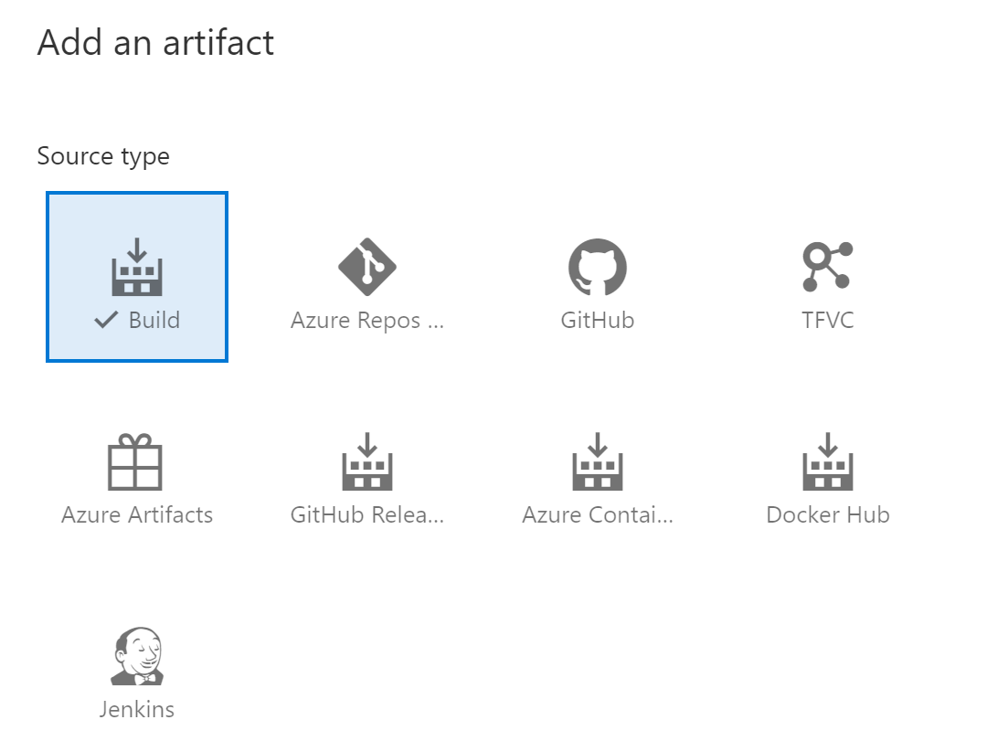
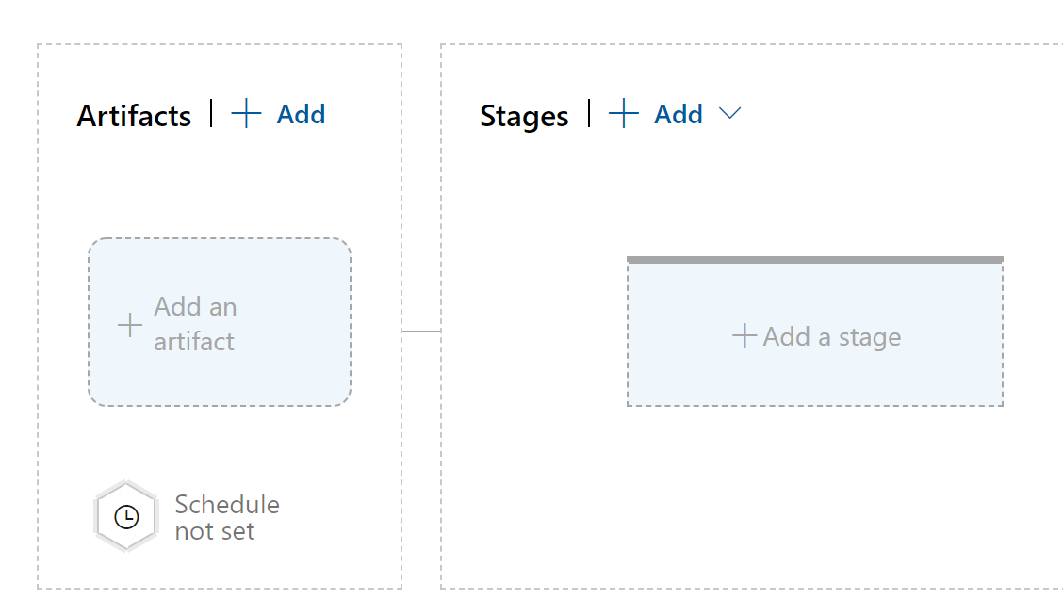
Configuring a Release Pipeline for .NET Core applications
New Release Pipeline
Select Artifacts

Slide 35
Configuring a Release Pipeline for .NET Core applications
New Release Pipeline
Select Artifacts
Define a Stage Template

Slide 36
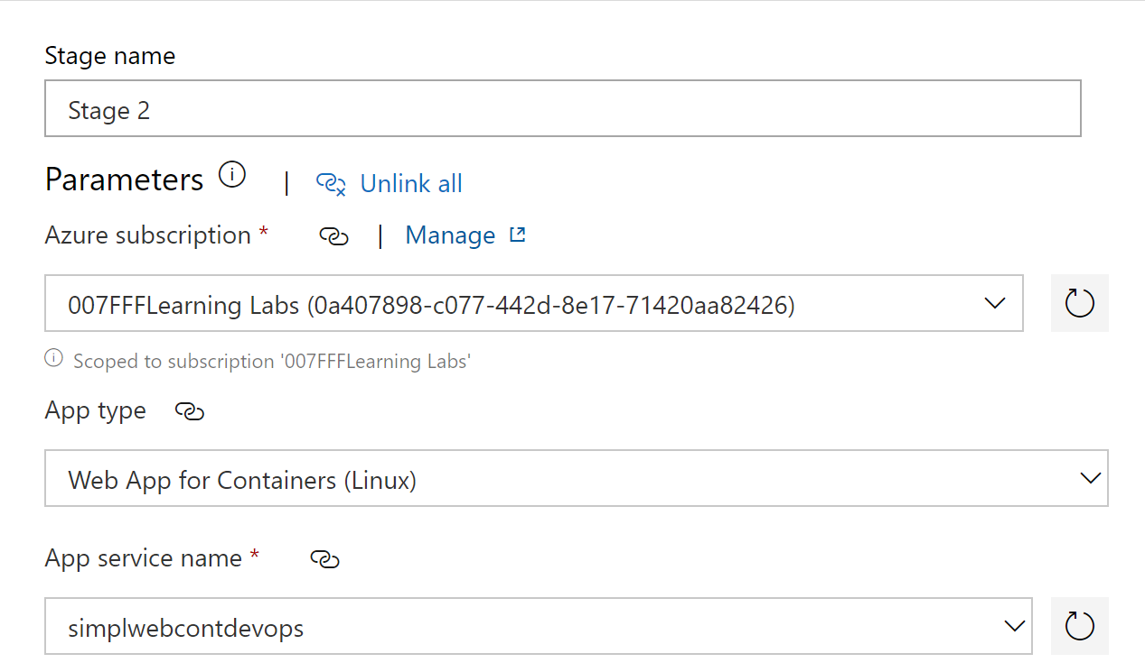
Configuring a Release Pipeline for .NET Core applications
New Release Pipeline
Select Artifacts
Define a Stage Template
Complete Stage Template parameters

Slide 37
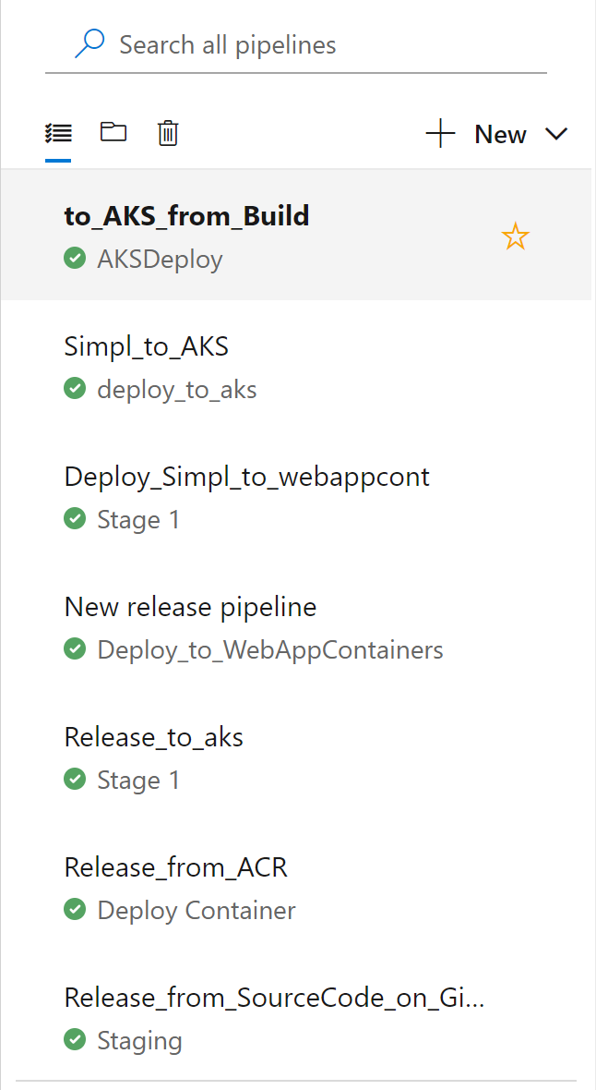
Configuring a Release Pipeline for .NET Core applications
New Release Pipeline
Select Artifacts
Define a Stage Template
Complete Stage Template parameters
Save & Run

Slide 38
Demo
Using Azure Pipelines to create your Release
From source code Build to Azure WebApps
From source container to Azure WebApps for Containers
From source container to AKS

Slide 39
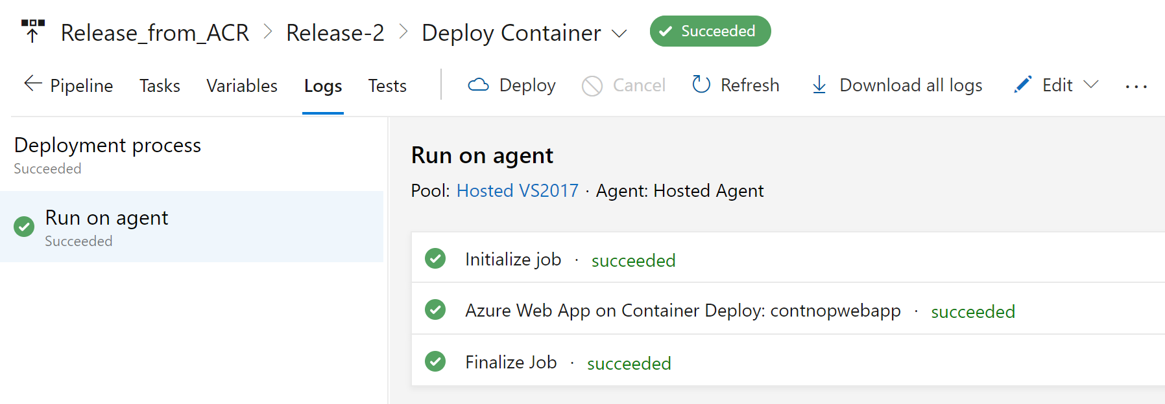
Monitoring a Release Pipeline for .NET Core applications
Full details of each step in the Release process
Succeeded / Failed
Duration of the Pipeline

Slide 40
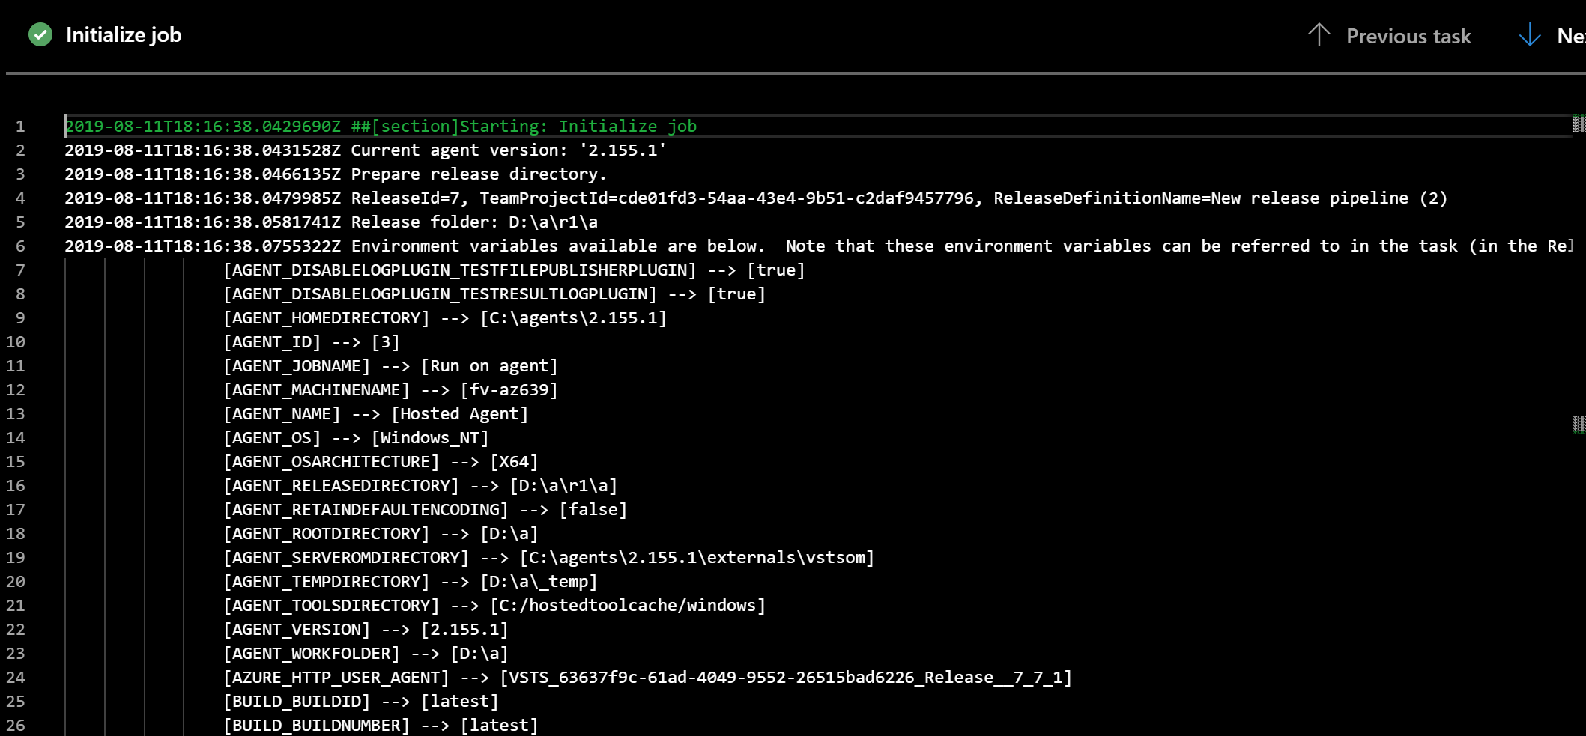
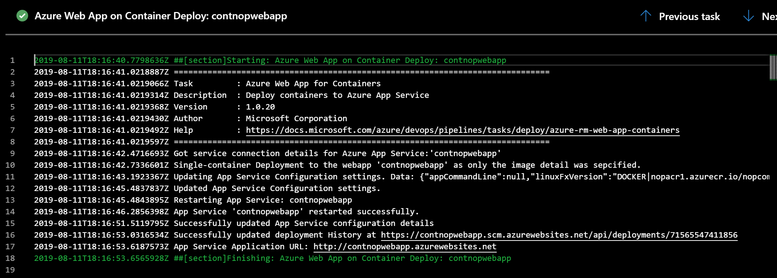
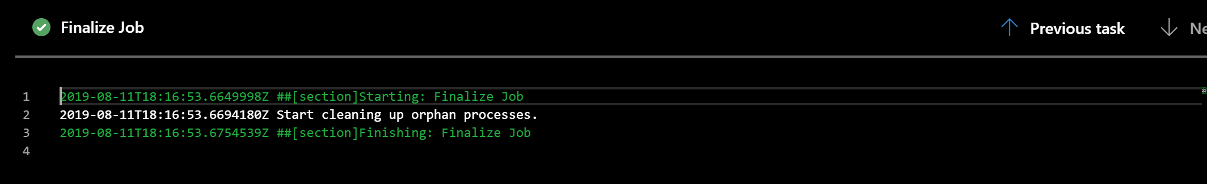
Monitoring a Release Pipeline for .NET Core applications
Full details of each step in the Release process

Slide 41
Demo
Monitoring Azure Pipelines

Slide 42
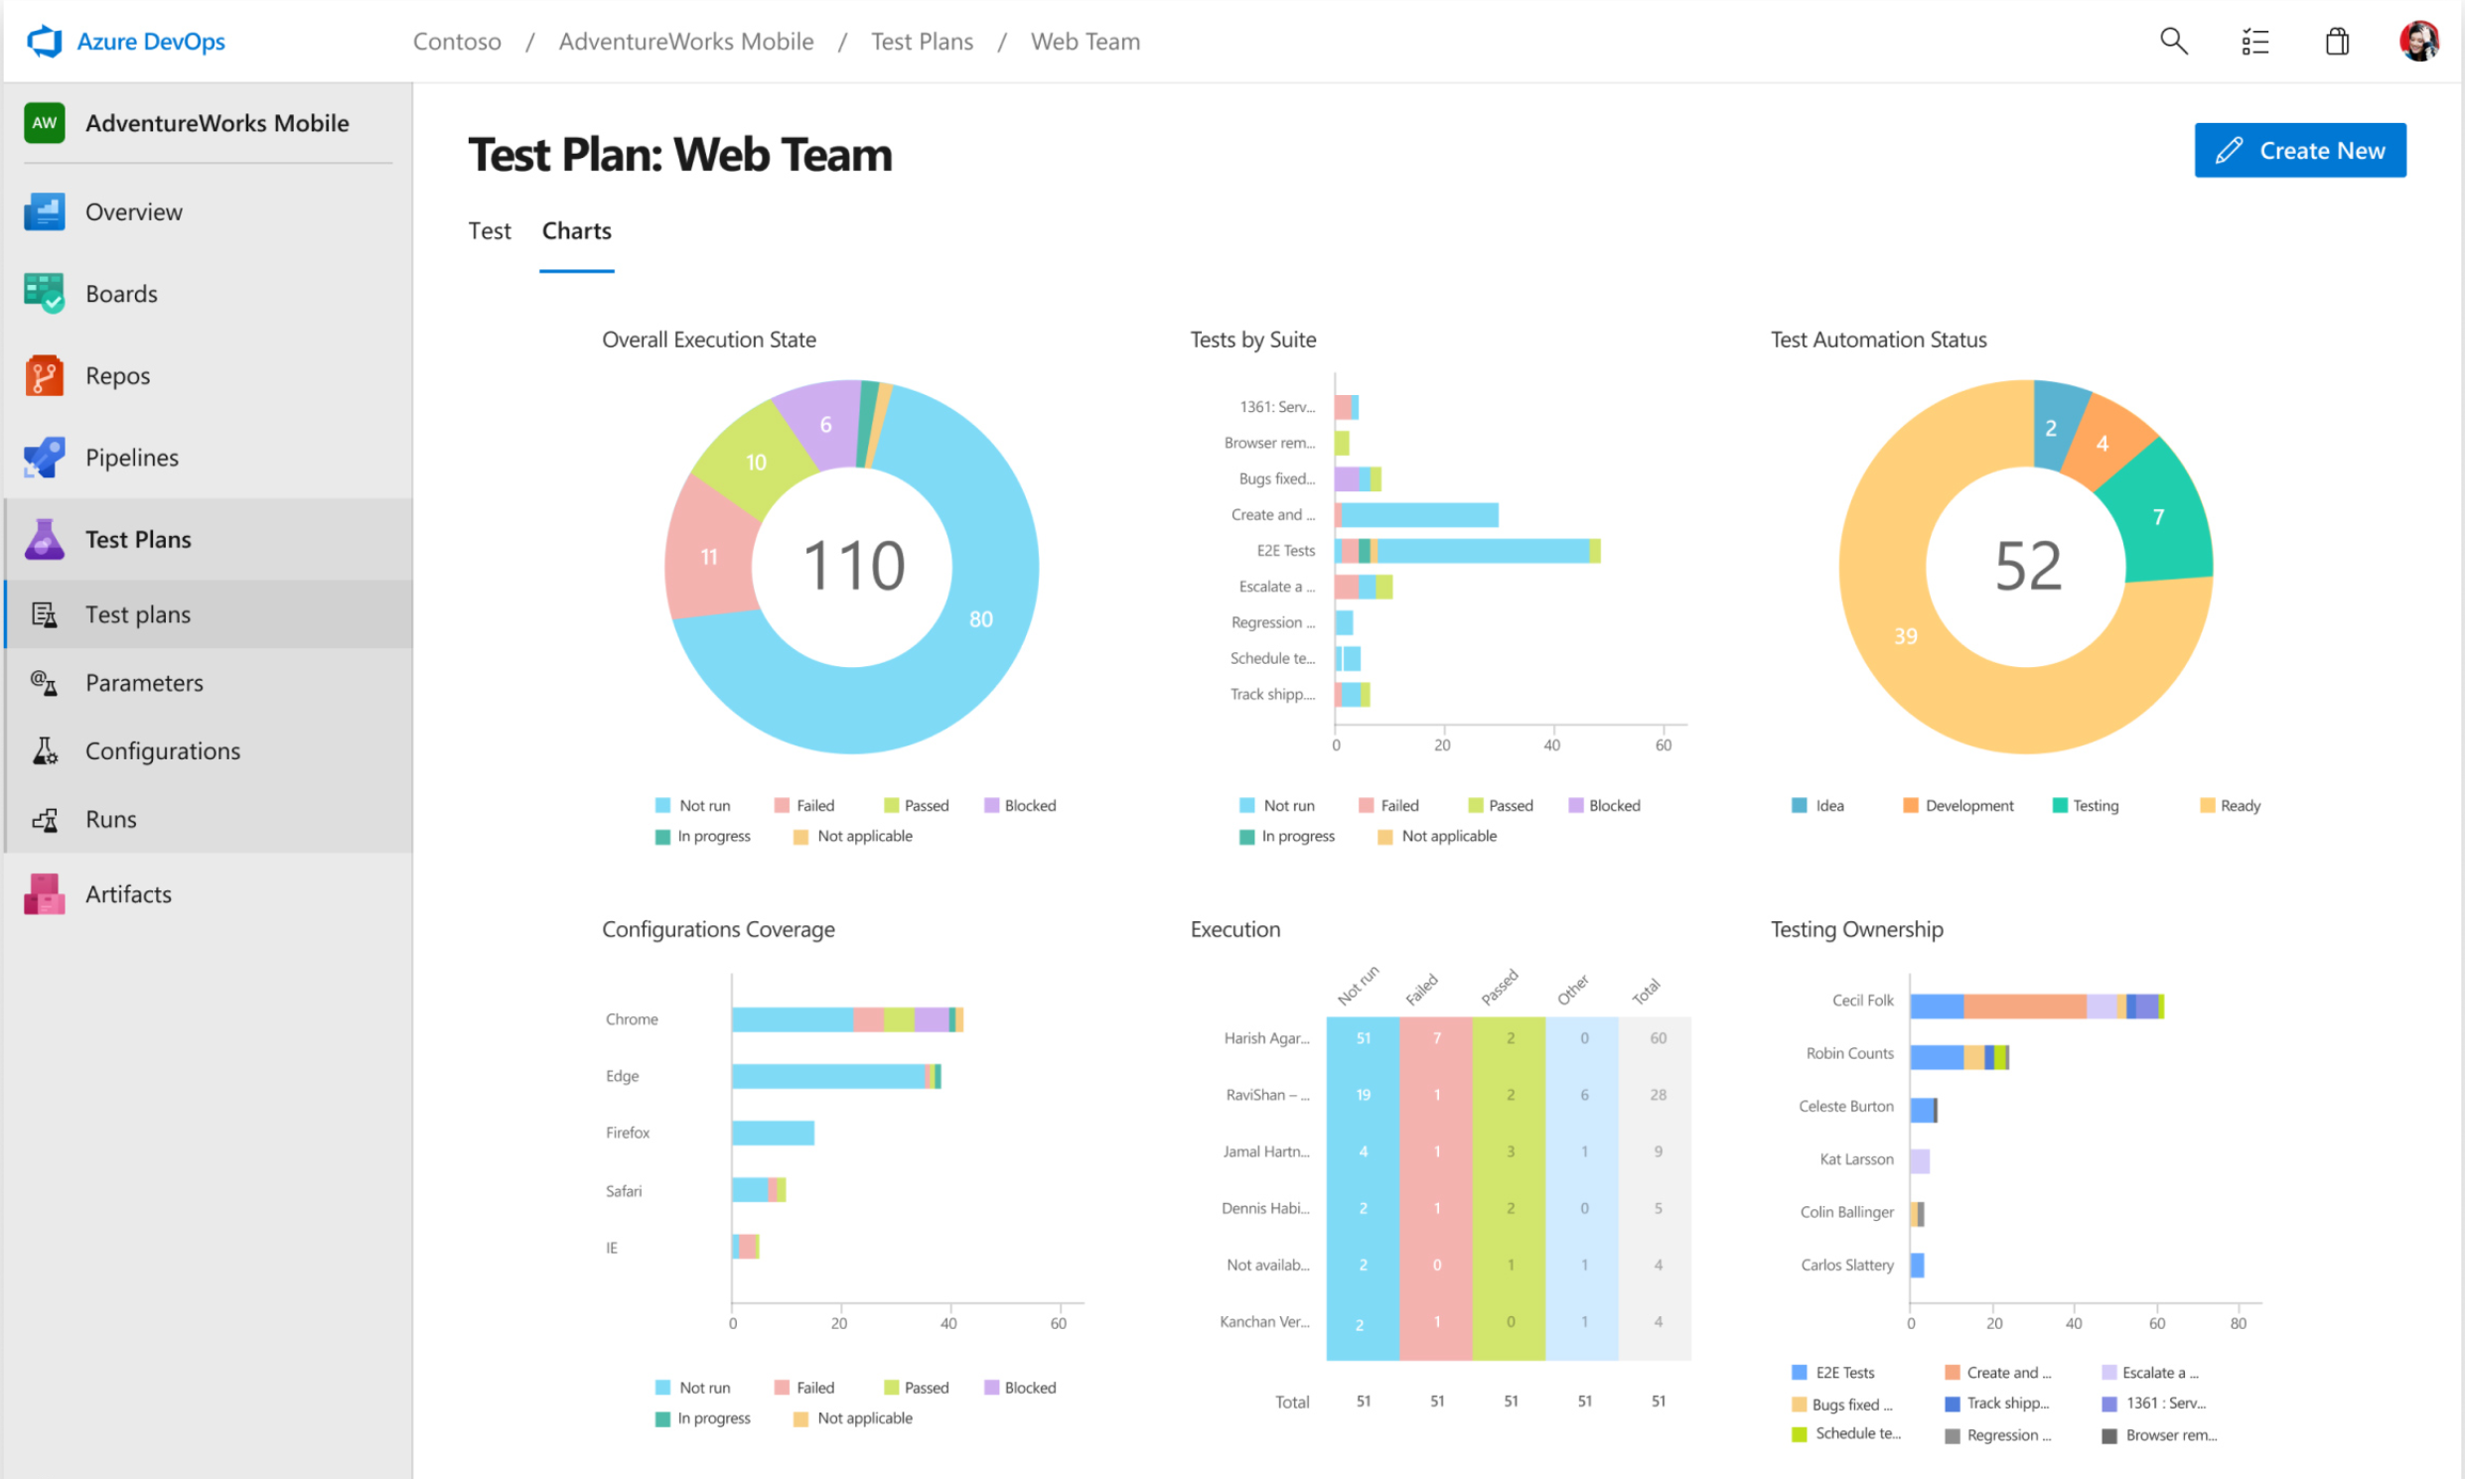


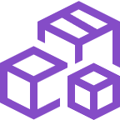
Azure Test Plans
Test and Ship with confidence using manual and exploratory testing tools
Test across web and desktop
Test your application by executing tests across different environments, from web apps to different desktop applications
Planned manual and automated tests
Plan, execute and track scripted tests with actionable defects and end-to-end traceability. Assess quality throughout the development lifecycle by testing your desktop and web applications
Unit & Functional Testing (VS2019)
Create a Unit Test project; Run Unit Tests with Test Explorer; Start using IntelliTest; Use code coverage to determine how much code is being tested
➔
https://azure.microsoft.com/en-us/services/devops/repos/

Slide 43
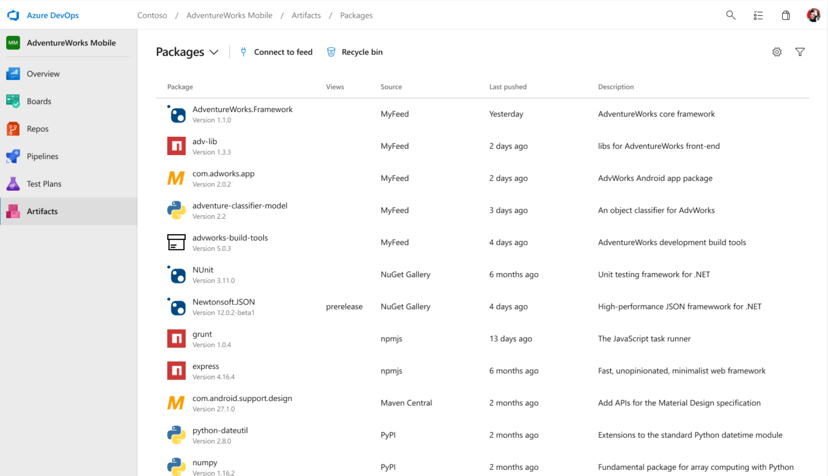



Azure Artifacts
Create, host and share packages with your team
Support for multiple package languages
Create and share Maven, NPM, NuGet, and Python package feeds from public and private sources
Keep your artifacts organized
Share code effortlessly by storing Maven, NPM, NuGet, Python packages together. And there is no need to store these in Git. Simply store them using Universal Packages in Azure Artifacts
Seamless Package handling
Integrate seamless package handling into your CI/CD Pipeline. Easily access all your artifacts in builds and releases.
➔
https://azure.microsoft.com/en-us/services/devops/repos/

Slide 44
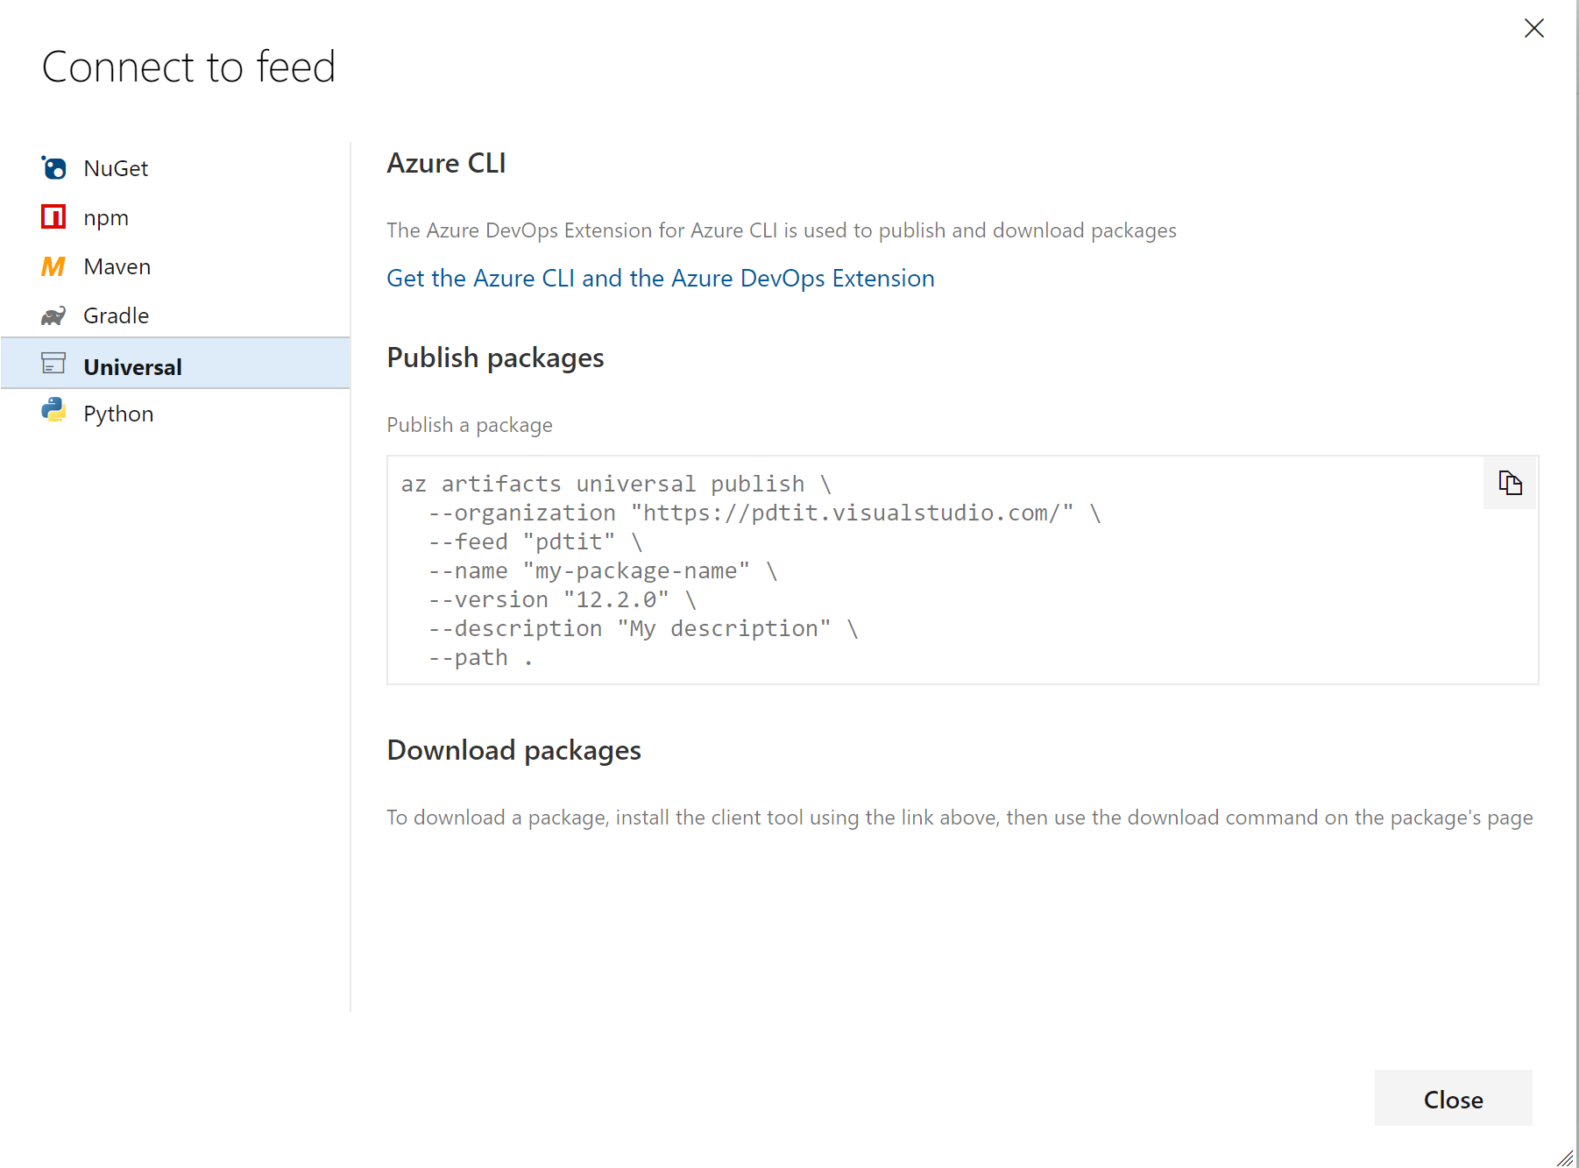
Azure Artifacts
Based on “feeds”
Private & Public
Multiple packages:
Maven, NPM, Nuget, Universal

Slide 45


Azure Pipelines
Microsoft Open Source
Free unlimited build minutes for public projects
Up to 10 free parallel jobs across Windows, Linux and macOS
➔
https://azure.com/pipelines

Slide 46

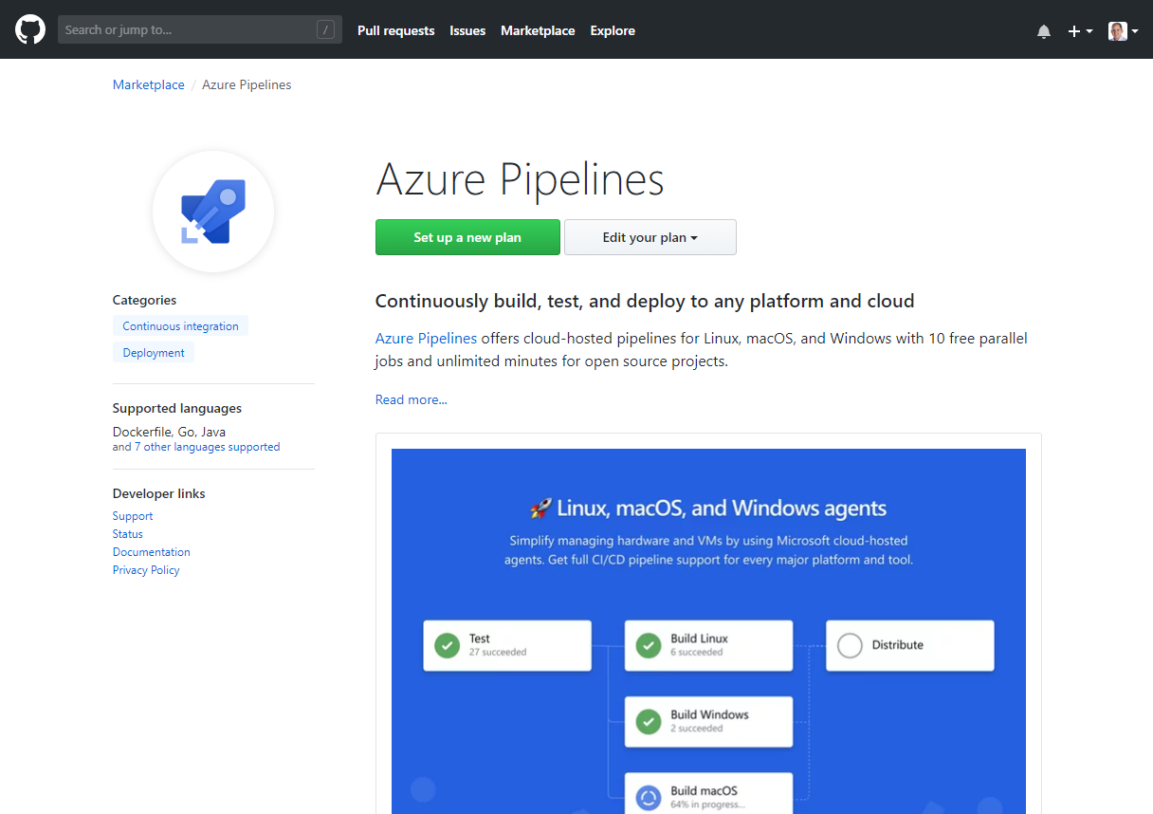
Integrated with GitHub
Azure Pipelines available now to any developer from the GitHub Marketplace

Slide 47
Azure DevOps Summary
Better together
Azure Boards
Azure Repos
Azure Pipelines
Azure Test Plans
Azure Artifacts
An end-to-end solution for organizations looking for an enterprise-grade toolchain
Fully Integrated with end to end traceability
Scalable to any team and project size
Highly available, multi region, hybrid cloud & on-prem
Customer Support
Consistent admin and access control
➔
https://azure.com/devops

Slide 48
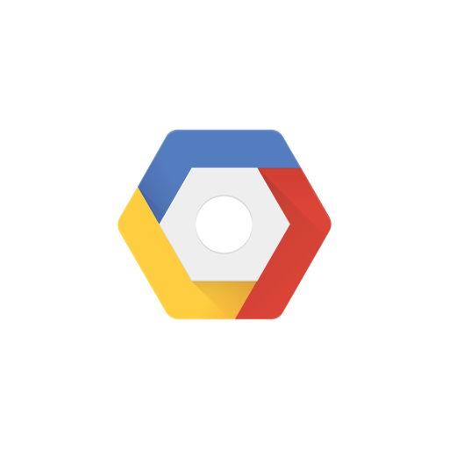

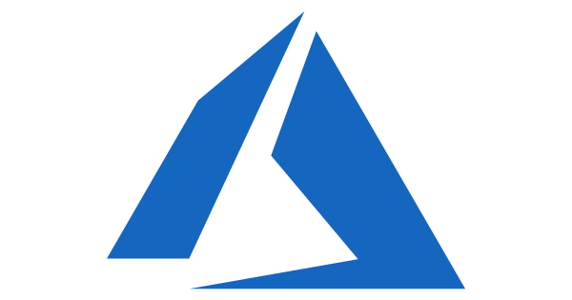

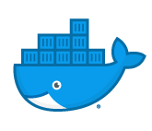
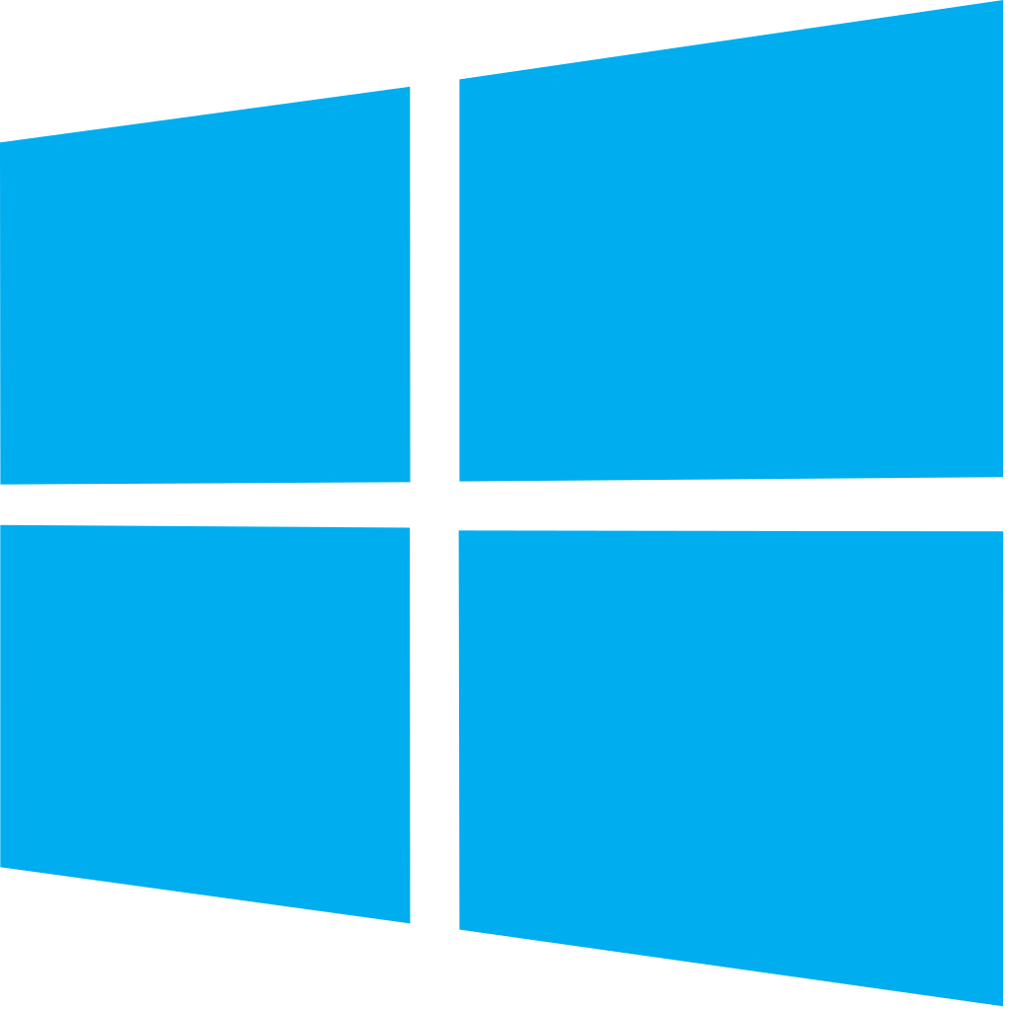


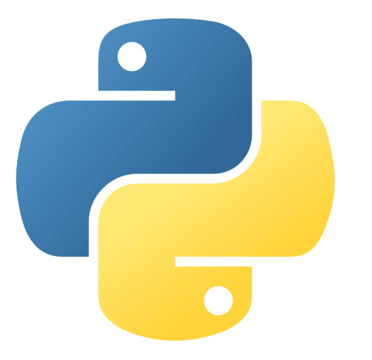

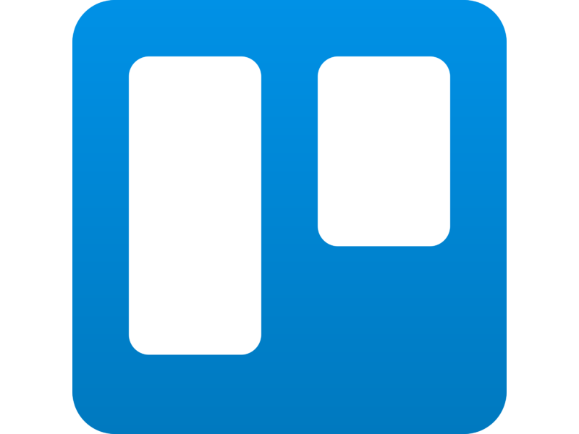
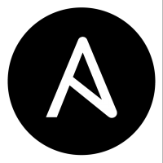

Azure DevOps: Choose what you love
Your tools, languages, and clouds
Any cloud, any platform, whether public, hybrid, on-premises
Developers are still in control of the language and process they want to keep using…
Azure DevOps integrates with existing dev tools, or can replace most of them… you choose!!

Slide 49
Section Take-Aways
Azure DevOps helps organizations in adopting and using DevOps… easier and better
Azure DevOps covers all aspects of the DevOps cycle: Repos, Build, Release, Artifacts,… end-to-end CI/CD Pipeline
Azure DevOps provides massive flexibility, by integrating with your existing Open Source tools you already use today

Slide 50
Questions
Landing
Spot
“…If you want good answers, ask better questions…”
© Randy Glasbergen

Slide 51
Next Module…
Monitoring & Operating your Azure application landscape
@pdtit @007FFFlearning

Slide 52
Thank You

